Slide 1
IoT-BBMS: An IoT-based Baby Monitoring System
Group Number - 13

Slide 2
Group Members
Harshal Abhyankar - 2019A3PS0282P (Team Lead)
Jagrit Lodha - 2019A3PS0165P
Shayan Majumder- 2019A3PS0259P
Anuj Milind Gore- 2019A8PS0339P

Slide 3
Problem Statement
Increasing number of women in modern workforce.
Increasing number of nuclear families.
High cost of human resource for constant monitoring of infants.
Need for smart, reliable and cost effective solutions for monitoring babies.

Slide 4
Introduction
Smart IoT based solution for monitoring infants remotely.
Use of cost-effective equipments.
Open source standards for mass production.
Use of cloud based solutions for later configurations.
Threat detection systems for emergency alarms.

Slide 5
Components Used- Software
Arduino IDE 1.8.16 for configuring ESP8266
Adafruit.io used for MQTT API configurations.
MQTT dash platform used for building IOT bbms App for remote monitoring and commanding cradle.
Thonny IDE for micropython for testing sensors and camera using ESP32.

Slide 6
Components Used - Hardware
ESP8266 (x 2) : Used as MCUs for connecting to WiFi and used for interfacing all the actuators and sensors.
Actuators :
DC Motor: Used to switch on the fan incase temperature increases beyond threshold.
Servo Motor: Used for swinging the cradle when required
Buzzer: Used for Alarm in case of emergency and playing music.

Slide 7
Components Used - Hardware
Sensors:
DHT 11: Used to monitor temperature and humidity.
Sound Sensor (KY037): Potentiometer is used to set sound threshold and accordingly digital data is sent to the MCU.
Camera (OV 7670): Used to capture baby images.

Slide 8
Key Features
Effective use of sound sensor to detect crying baby.
Music played using buzzer.
MQTT protocols used to connect to mobile app over WiFi.
Threat detection system for baby protection.

Slide 9
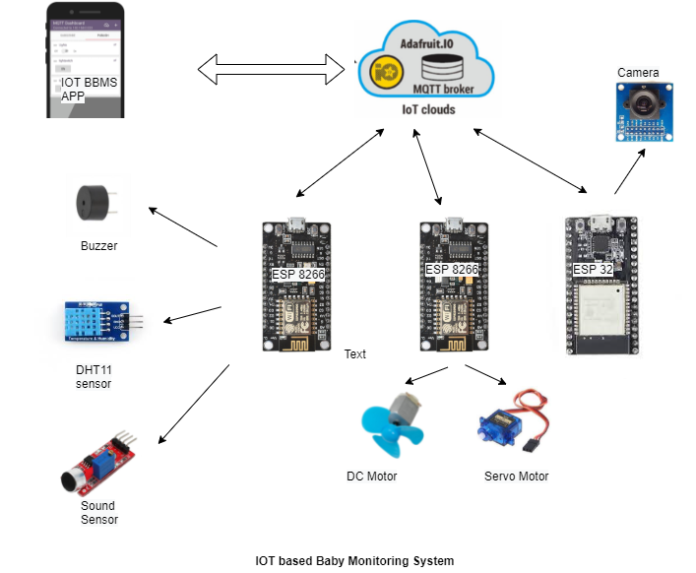
Flowchart

Slide 10
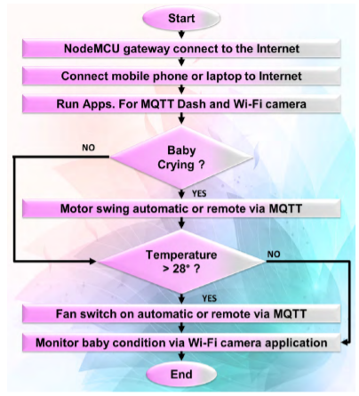
Flowchart - Logic

Slide 11
Future Work
Improve code reliability for corner cases.
Integrate everything into one MCU and use async mechanisms.
Manufacturing of proper wooden cradle.
Use of relay for motors.

Slide 12
References
https://ieeexplore.ieee.org/document/8760478
https://learn.adafruit.com/adafruit-io/mqtt-api
https://lemariva.com/blog/2019/09/micropython-how-about-taking-photo-esp32

